Slide 1

Voxellancer
I believe I can fly
by Patrick Siegler, Sebastian Gerstenberg, Christian Dullweber and Moritz Eyssen under guidance of Daniel Limberger

Slide 2
Motivation

Slide 3
Features
(eine übersicht?)

Slide 4
WorldTree
…

Slide 5
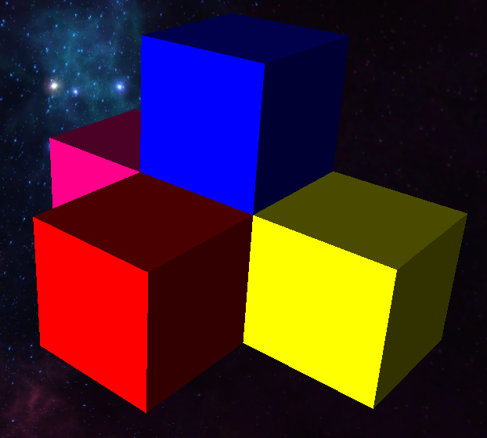
VoxelCluster
Represent all entities
Datastructures
std::unordered_map<glm::ivec3, Voxel*>
VoxelTree
std::set<Voxel*, VoxelGridCmp<XAxis>>
std::set<Voxel*, VoxelGridCmp<YAxis>>
std::set<Voxel*, VoxelGridCmp<ZAxis>>

Slide 6
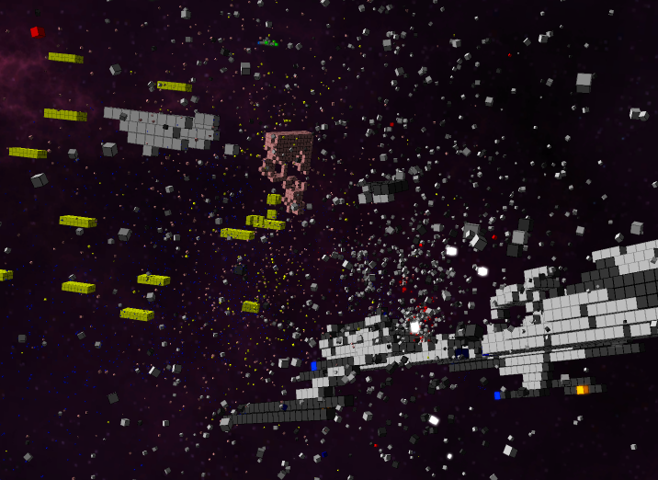
Particles
Simulated on GPU
struct VoxelParticleData { glm::vec3 creationPosition; glm::vec3 creationEulers; glm::vec3 directionalSpeed; glm::vec3 angularSpeed; float creationTime; float deathTime; float scale; uint32_t color; float emissiveness; };
VertexShader:
float timeDelta = currentTime - creationTime;
vec3 particlePosition = directionalSpeed * timeDelta + creationPosition;
vec3 eulers = angularSpeed * timeDelta + creationEulers;
vec4 orientation = quat(eulers);
gl_Position = viewProjection * vec4(qtransform(orientation, v_vertex) * scale + position, 1.0);
→ Very few buffer updates neccessary!

Slide 7
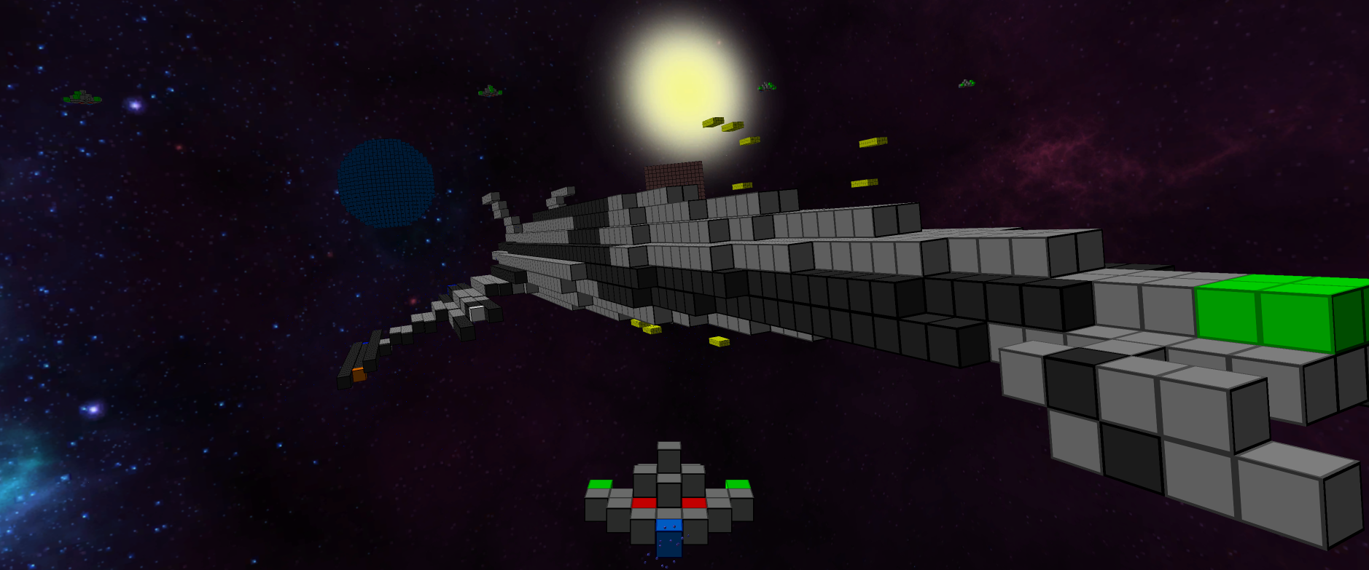
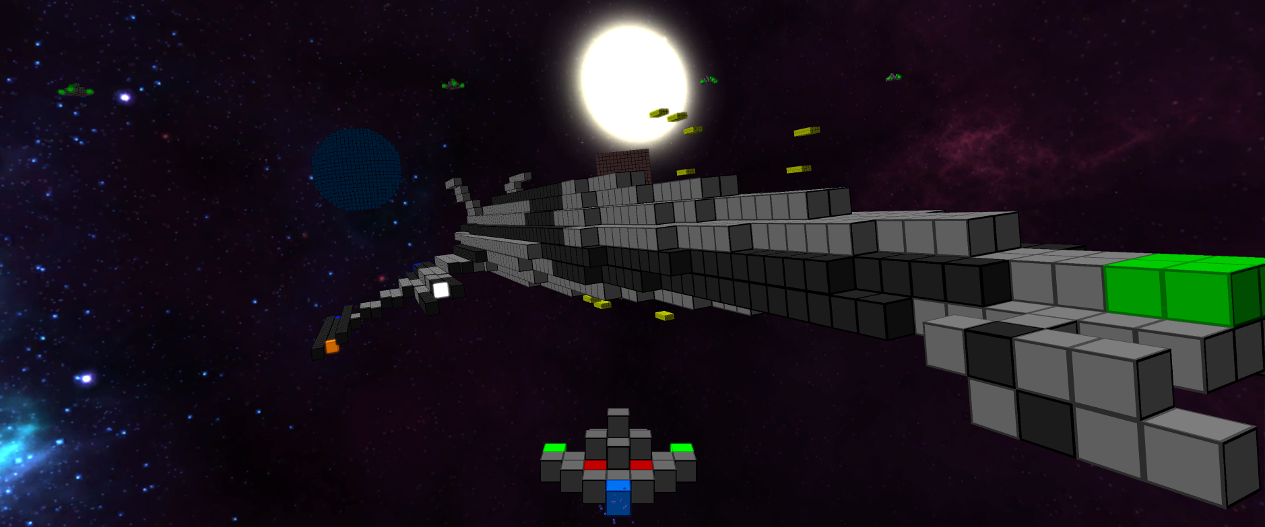
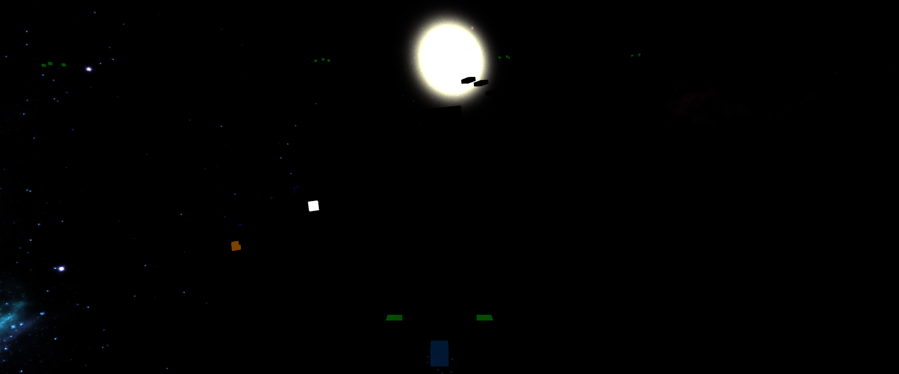

Postprocessing

Slide 8
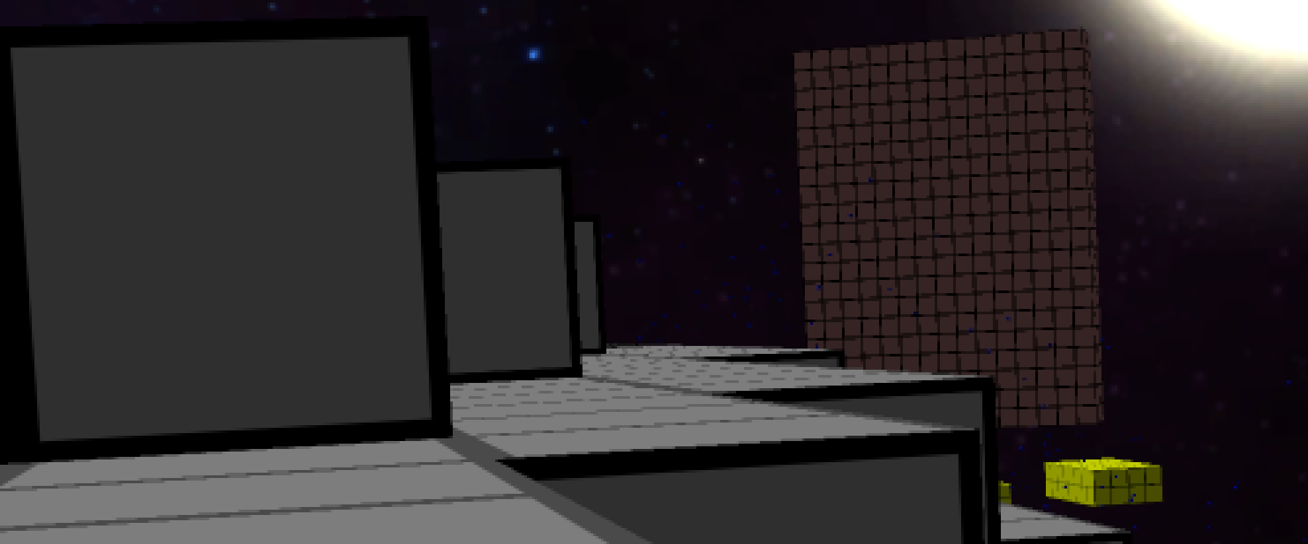
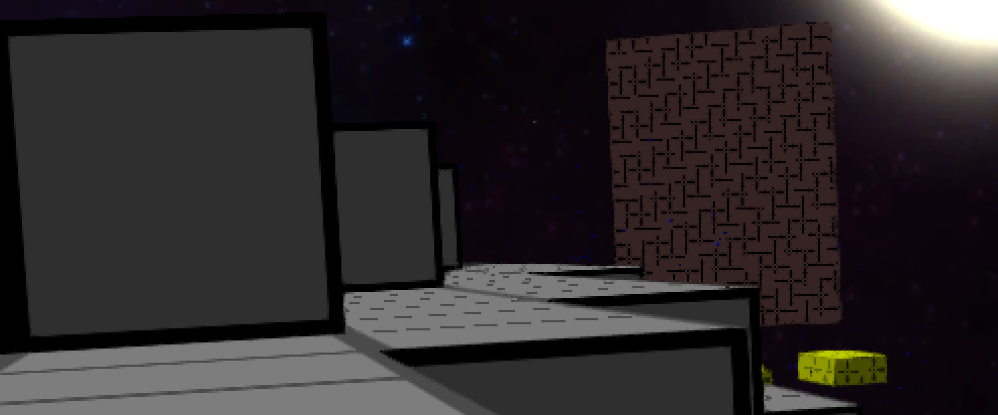

Antialiasing
fxaa
2x super sampling
without

Slide 9
Libraries & Tools
GLFW
GLOW
GLEW
GLM
SFML Audio
OculusSDK
LUA
Elemate Lua Bindings
Bandit
Git
github.com/voxelinc/voxellancer
Jenkins

Slide 10
Statistiken & Fakten

Slide 11
